Slide 1
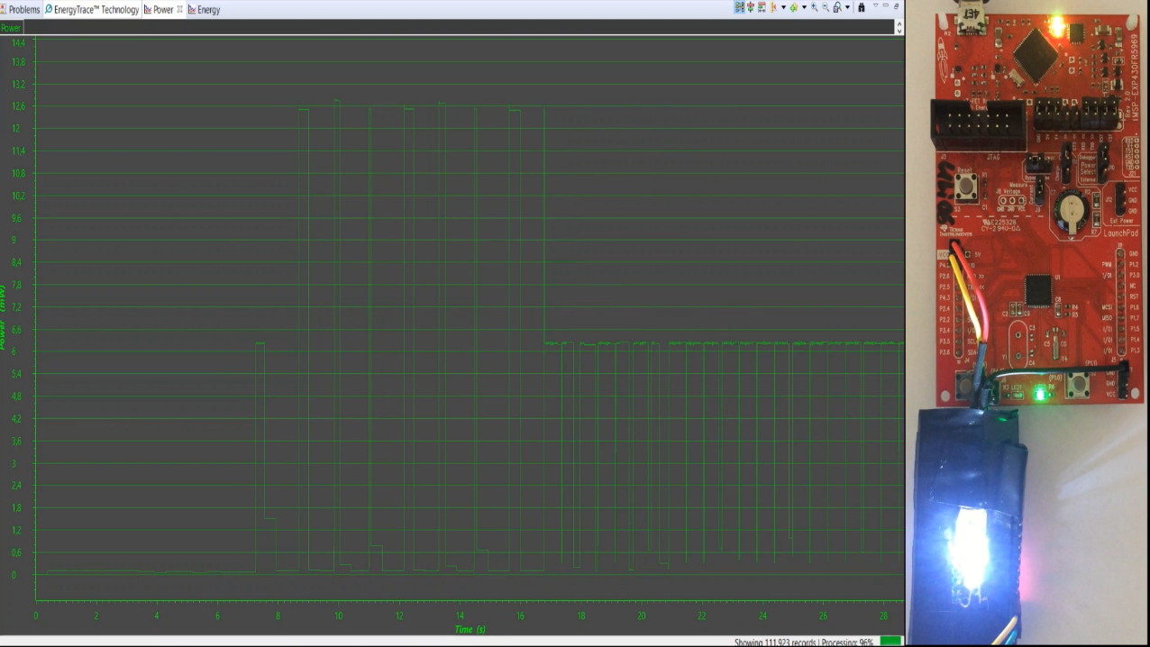
Final Project - Coin cell Challenge
Presented by
Henry Ugochukwu Odoemelem
on
20.07.2020
Florian Willing,
Prof. Dr. Kristof Van Laerhoven
Ubiquitous Systems Lab, University of Siegen, Germany.

Slide 2
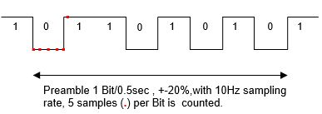
FSM based implementation diagram
Preamble terminated
Error
1
0
0
1
0
1
0
1
0
1
1
0
1
1
0
Ack. completed
Light present and measurement done
BIT0
BIT1
BIT2
BIT3
BIT4
BIT5
BIT6
BIT7
Ack.
Measure
Transmit
0
init
Start preamble
Light present
Sleeping
Light not present
Wake up
Light not present or transmission done
Sleeping
Reset all flags just before sleeping.
Just before sleeping turn on LED2 for 1 sec, if terminated abruptly.
On sleep mode LPM3, ADC on 50Hz sampling using timer TA0 with ACLK 10kHz with prescalar of 4 to get 2500Hz.
Waking Up
Flashlight and modulation with hand, implemented using a blinking code on ESP32 MCU.
Light present for 3.27 sec Watch dog timer interval, go to 10Hz sampling rate for preamble.
Preamble
ADC sampling rate of 10Hz (i.e. 1sample/0.1seconds) with TA0.
Receiver circular buffer.
FSM delay with LPM3, until new next bit is received.
If preamble is correct, set 50Hz ADC sampling rate with TA0.
On Bit error, quit program and go to Sleeping.
Acknowledgement
Turn LED2 on for 250ms using TA1, with LPM3 as delay.
ESP32
MSP430
MSP430

Slide 3
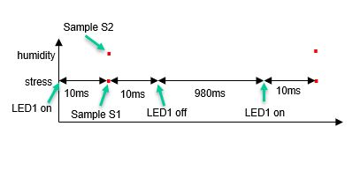
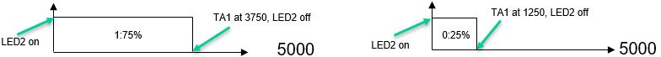
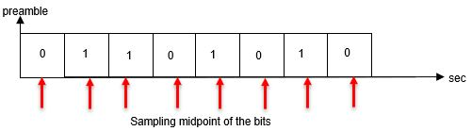
Stress and humidity measurement
Delay 10 ms with TB0CCR1 and LPM3, then turn off LED1.
Delay 980 ms with TB0CCR1 and LPM3, then turn on LED1.
Delay 10 ms with TB0CCR2 and LPM3, then read the state of S1 (stress) and S2 (humidity) simultaneously into transmit buffer.
Repeat process 8 times.
Transmission
TA1 in up mode with 10kHz ACLK , TA1CCR0 for 0.5sec bit period, and TA1CCR2 for Duty cycle (1:75% , 0:25%).
Delay with LPM3 .
In TA1CCR0 ISR, assign TA1CCR2 with appropriate count value to switch LED2, until transmit buffer is empty.
Quit program and go to Sleeping.
Termination
If light source absent for 20ms, i.e. one ADC sampling period, set user defined exit flag, quit program and go to Sleeping.
Challenges: Reading the preamble
Initial approach: +-20% error margin not considered.
Current approach: +- 20% error margin is considered but error margin realized is 0.45 sec to 0.675 sec bit period.

Slide 4
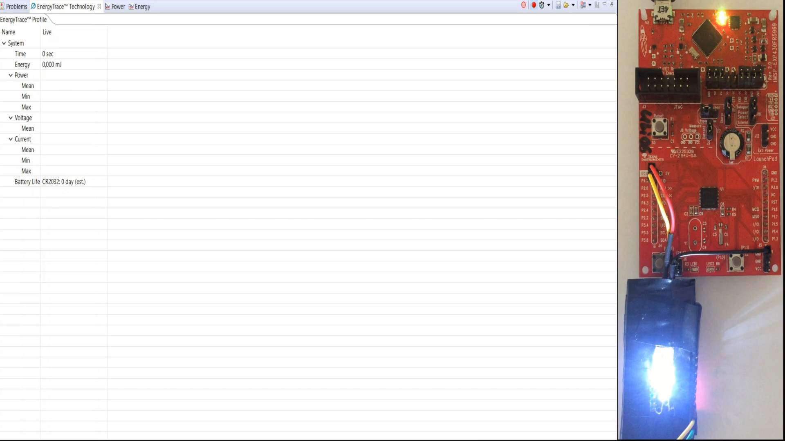
Enjoy the video demonstration and thank you for your kind attention!!!
Main benefits of this approach
User friendly design.
Ultra low power consumption; Task mode: 0.87 mA, 3.12mW and Idle mode : 14.4µA , 51.7 µW.
GitHub repository for source code : https://github.com/hodoemelem/MSP430-Coin-Cell-Project

